Slide 1
LLM + AI Agents for QA Automation
Automated Testing using AI
Jira → Test Cases → Execution → Reports

Slide 2
What are AI Agents?
• AI Agent = Intelligent software that performs tasks automatically
• Works without human intervention
• Can read Jira tickets
• Generates test cases
• Executes tests
• Creates reports
• Takes decisions based on results

Slide 3
What is an LLM?
• LLM = Large Language Model (example: ChatGPT)
• Understands and generates human language
• Reads requirements and user stories
• Can create test cases automatically
• Helps in decision making and automation
• Learns from data and instructions

Slide 4
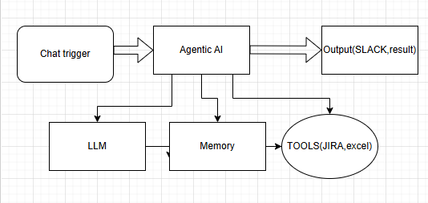

Slide 5
JIRA STORY → LLM UNDERSTANDING
Objective: Validate that the LLM correctly understands requirements from Jira stories.
Functional Test Cases
Verify LLM extracts:
  Acceptance criteria correctly
  Business rules
  Preconditions
  User roles
  Edge cases
Validate story parsing from different formats:
  Structured stories
  Poorly written stories
  Multi-scenario stories
Check handling of:
  Ambiguous requirements
  Missing acceptance criteria
  Conflicting requirements
Validate mapping:
  Jira ID → Test Scenario
  Story → Test objective
Non-Functional
Response time of LLM understanding
Accuracy % of requirement interpretation
Hallucination detection
Negative Testing
Empty story
Non-functional requirement story
Very large story description
Unsupported language

Slide 6
2. AI Test Case Generator
Objective: Ensure AI generates complete, relevant, and structured test cases.
Functional Test Cases
Verify generated test cases include:
  Test ID
  Test steps
  Expected result
  Test data
  Priority
  Precondition
Validate test coverage:
  Positive scenarios
  Negative scenarios
  Boundary value cases
  Edge cases
Verify traceability:
  Test case → Jira story mapping
Check duplicate test case detection
Validate test case format consistency
Quality Validation
Test case completeness score
Coverage score
Risk-based prioritization accuracy
Negative Testing
Incomplete requirement input
Conflicting acceptance criteria
Large feature scope

Slide 7
3. Automation Script Creation
Objective: Validate AI converts test cases into executable automation scripts.
Functional Test Cases
Verify script generation for:
  UI testing
  API testing
  Database validation
Validate:
  Locator identification
  Dynamic element handling
  Reusable functions
  Page Object Model structure
Check language compatibility:
  Selenium Java
  Python
  Playwright etc.
Validate test data parameterization
Technical Validation
Script compilation success
Dependency management
Framework integration
Negative Testing
Element not found
Changing UI locator
Unsupported technology stack

Slide 8
4. Test Execution Engine
Objective: Ensure test scripts execute correctly in automated environments.
Functional Test Cases
Validate execution modes:
  Parallel execution
  Sequential execution
Environment validation:
  QA
  Staging
  Production-like
Validate:
  Retry mechanism
  Failure handling
  Timeout handling
Verify CI/CD integration
Performance Testing
Execution time tracking
Resource usage
Scalability with multiple test suites
Failure Simulation
Network failure
Server downtime
Browser crash

Slide 9
5. Results + Monitoring
Objective: Ensure accurate logging, reporting, and failure analysis.
Functional Test Cases
Verify result capture:
  Pass / Fail
  Error logs
  Screenshots
  Video recording
Validate defect auto-creation in Jira
Verify root cause classification:
  Script issue
  Environment issue
  Application defect
Monitoring Validation
Real-time execution monitoring
Alert notification system
Test trend tracking
Data Integrity
Result storage consistency
Historical comparison accuracy

Slide 10
6. AI Dashboard & Insights
Objective: Validate analytics, reporting, and decision-making insights.
Functional Test Cases
Verify dashboard metrics:
  Test coverage
  Failure trends
  Execution success rate
  Defect density
Validate predictive insights:
  Risk prediction
  Failure probability
Verify filtering:
  By release
  By module
  By environment
Visualization Testing
Chart accuracy
Data refresh frequency
Export reports (PDF / Excel)

Slide 11
Thank You
AI Driven Testing = Faster Delivery + Better Quality

